Slide 1
ZENVEST: Smart SIP & ETF Portfolio Analyzer
Automated Wealth Allocation & Algorithmic Hedging Tool
Department of Computer Science and Engineering and Business Systems (CSEBS)
PRESENTED BY:
1 . Kailash
2.Joshua
3. Arjun Raj 4. Ashar
Guide: Sudharshan
PAGE 001

Slide 2

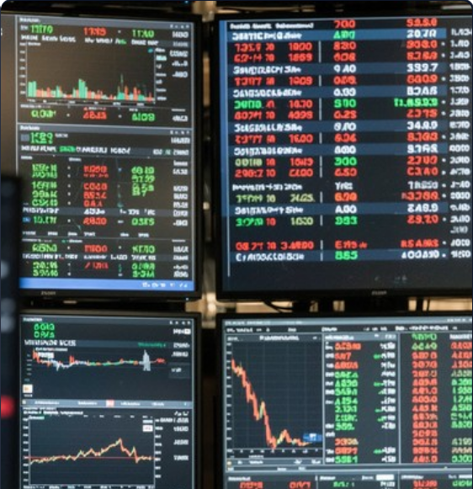
PROBLEM STATEMENT
STOCKMARKET ANALYSIS
High Hidden Commissions
Traditional local brokers charge high hidden commissions on regular mutual funds (up to 1 .5% annually), eroding long-term investor compounding.
Emotional Decision Making
Retail investors often make panic-driven decisions during market
crashes without a systematic risk-hedging mechanism.
Complex& Cluttered Tools
Existing trading platforms are overly complex, jargon-heavy, and
overwhelming for beginners looking for straightforward wealth growth.
PAGE 002

Slide 3

ABSTRACT
STOCKMARKET ANALYSIS
Global Insights & Automated Allocation
Zenvest is an intelligent Wealth Allocation and SIP Forecasting System designed to automate personal investing for young professionals.
Proven Methods & Risk Proﬁle
The application evaluates user risk tolerance and automatically divides investments across high-growth Direct Mutual Funds and stable Gold ETFs.
Trusted Advice & Discipline
The project aims to el iminate emotional investing, drastically reduce broker fees, and provide a clear, data-driven roadmap to ﬁnancial independence.
PAGE 003

Slide 4






PROPOSED SOLUTION
STOCKMARKET ANALYSIS
1 . Dynamic User Proﬁling
2. Rule-Based Allocation
3. Risk Hedging (Gold)
Risk Capacity Assessment: Time horizon is crucial. A 1 5-year horizon withstands market volatility for aggressive equity al location, while a 3-year horizon prioritizes stability.
Direct Mutual Funds: Replaces regular funds (1
-1 .5% broker commissions) with Direct funds, saving lakhs over long compounding horizons.
Inverse Asset Correlation: Equities and Gold move inversely. Gold ETFs act as an automate d "shock absorber" during stock market downturns.
PAGE 004

Slide 5
KEY ADVANTAGES
STOCKMARKET ANALYSIS
Emotionless Asset Allocation
Automated Risk Hedging
Maximum Cost-Eﬃciency
Steers users toward Direct Mutual Funds, el iminating 1 –2% hidden middleman commissions found in regular funds and removing panic-driven decisions.
Protects user capital during severe market crashes by dynamically balancing high-risk equities with the stability of Gold ETFs.
Completely removes human bias, greed, and market anxiety by enforcing strict mathematical discipline across compounding horizons.
PAGE 005

Slide 6
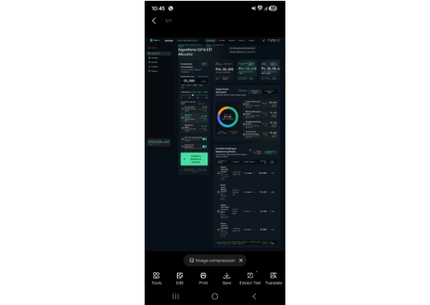
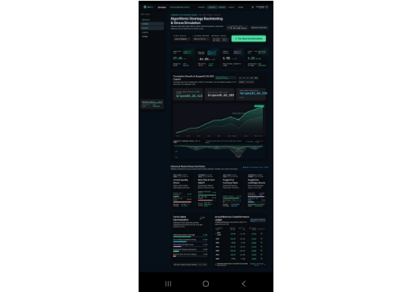
SYSTEM IMPLEMENTATION
STOCKMARKET ANALYSIS
PAGE 006

Slide 7
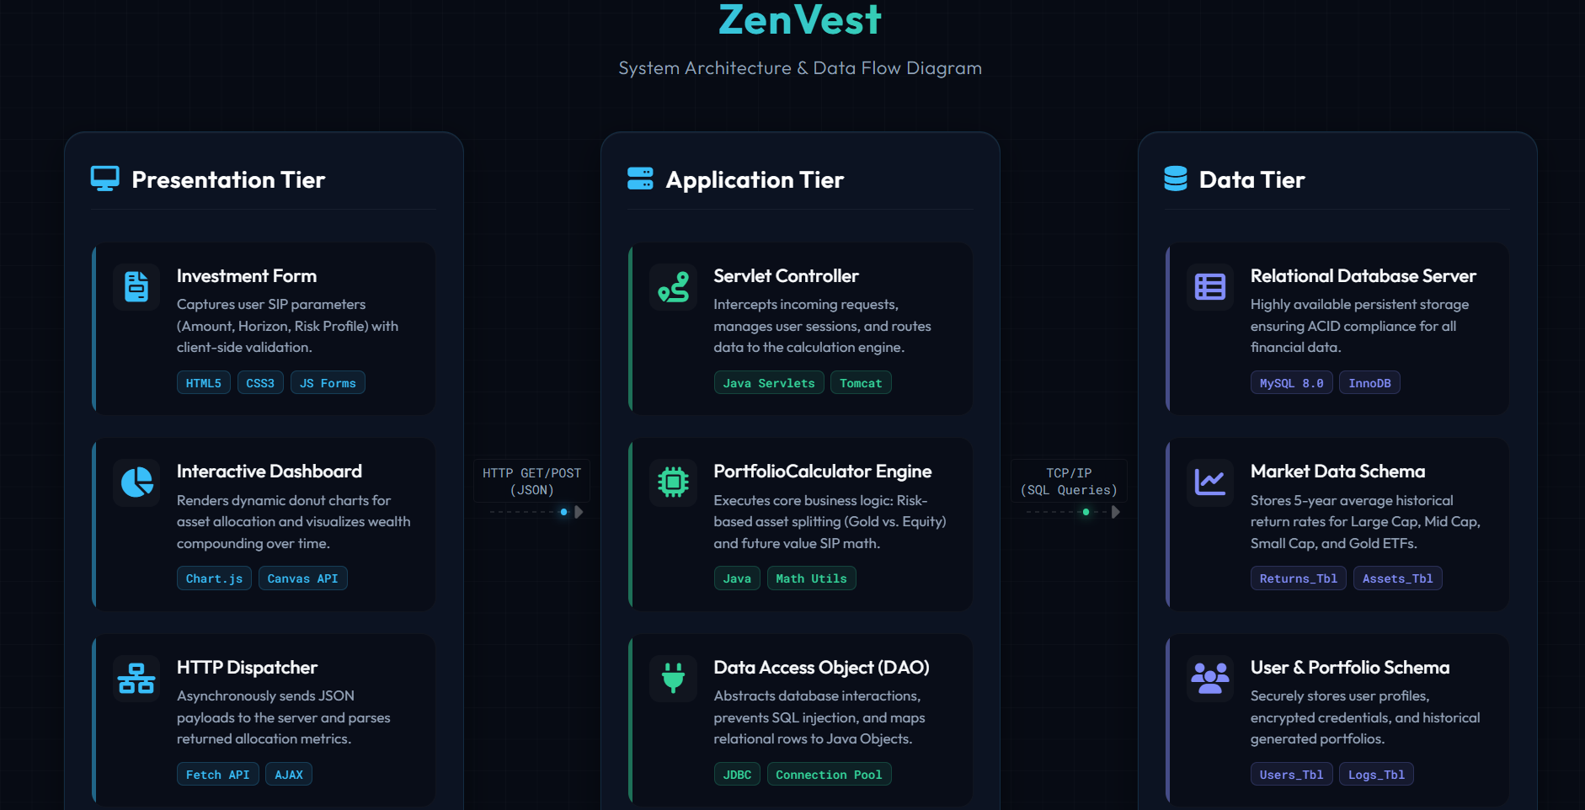
SYSTEM ARCHITECTURE
STOCKMARKET ANALYSIS
PAGE 007

Slide 8
TEAM CONTRIBUTION:
1. Kailash M. (Frontend & Integration): Designed the UI/UX with HTML5, CSS3, and JavaScript; handled client-side logic, Chart.js integration, and frontend-to-servlet communication.
2. Ashar (Backend Logic): Implemented the Java controller, risk categorization engine, and mathematical formulas for SIP compounding and future returns.
3. Joshua (Database & JDBC): Designed the MySQL schema, managed user and market benchmark data tables, and configured the JDBC connectivity layer.
4. A+rjun Raj (Research & Documentation): Researched asset allocation models and Gold ETF hedging; drafted system notes, base paper alignment, and documentation.
PAGE 008

Slide 9
REFERENCES:
[1] S.-H. Kim and K.-H. Lee, "Multi-Asset Multi-Agent Reinforcement Learning for Portfolio Management," IEEE Access, 2025. [2] H. Markowitz, "Portfolio Selection," The Journal of Finance, vol. 7, no. 1, pp. 77-91, 1952.
[3] E. F. Fama and K. R. French, "Common risk factors in the returns on stocks and bonds," Journal of Financial Economics, vol. 33, no. 1, pp. 3-56, 1993.
[4] D. Ardia, K. Bluteau, and M. Boudt, "Questioning the news about economic growth: Sparse forecasting using thousands of news-based sentiment values," International Journal of Forecasting, vol. 35, no. 4, pp. 1370-1386, 2019.
[5] C. S. Horstmann and Oracle Corporation, Core Java, Volume I: Fundamentals, 12th ed. Boston, MA: Pearson Education, 2022.
[6] R. Nixon, Learning PHP, MySQL & JavaScript: With jQuery, CSS & HTML5, 5th ed. Sebastopol, CA: O'Reilly Media, 2018.
PAGE 009

Slide 10
CONCLUSION:
The ZenVest project successfully demonstrates a highly automated, algorithmically driven approach to retail wealth management, effectively bridging the gap between institutional-level financial strategies and everyday investors.
By systematically capturing a user's risk tolerance, time horizon, and monthly investment budget, the system dynamically generates a personalized asset allocation strategy. Replacing emotional investing with mathematical precision, the core engine optimally divides capital between high-growth, zero-commission Direct Mutual Funds and inverse-correlated Gold ETFs to ensure robust downside protection.
Technologically, the implementation of a rigorous Model-View-Controller (MVC) architecture ensures seamless communication between the interactive frontend dashboard and the secure Java-based backend processing engine. This infrastructure not only provides instantaneous wealth forecasting through precise SIP compounding algorithms but also establishes a highly scalable foundation for future enhancements.
PAGE 010

Slide 11


IMAGE SOURCES
https://images.stockcake.com/public/4/3/1 /431 9e262-b76d-40af-85fc-2920d5984859_large/market-data-dashboard-stockcake.jpg
Source: stockcake.com
https://img.magniﬁc.com/premium-photo/stack-gold-coins-with-ﬁnancial-market-stock-chart-business-growth-chart_3881 0-9653.jpg
Source: www.magniﬁc.com
PAGE 010

Slide 12
Thank You!
Zenvest: Smart SIP & ETF Portfolio Analyzer
Department of CSEBS | Review 2 Presentation
PAGE 011

